Slide 1








BRICS Demo
Query Tool and APIs
Biomedical Research Informatics Computing System (BRICS)
April 11th, 2024

Slide 2
Logistics
Audio/Video | Please keep your microphone muted
Recording | Today’s session will be recorded Will be posted on the BRICS website: https://brics.cit.nih.gov/demo
Questions & Comments | We encourage your participation today Please use the chat for questions & comments. The chat will be monitored throughout today’s demo. There will also be time after each speaker and at the end of the demo to ask live questions.

Slide 3
Agenda
Time | Topic | Speaker(s)
9:00 AM-9:10 AM | Introduction and Query Tool Overview | Dr. Matthew McAuliffe
9:10 AM-9:25 AM | Demo on NIA Use Case for Query Tool | Dr. Saba Al-Sayouri Data Scholar
9:25 AM-9:40 AM | Query Tool APIs and Visualization | Dr. Alexandra Bokinsky
9:40 AM-9:55 AM | BRICS APIs and Analysis | Dr. Maria Bagonis Data Scholar
9:55 AM-10:00 AM | Questions & Closing Remarks | Dr. Matthew McAuliffe

Slide 4
BRICS - Brief Introduction
Matthew J. McAuliffe, PhD (Biomedical Engineering)
Chief, Scientific Applications Services (SAS), CIT
Home | BRICS (nih.gov)
https://brics.cit.nih.gov

Slide 5


Building from existing projects
National Database for Autism Research (NDAR)
GOVERNMENT SYSTEMS
GOVERNMENT INITIATIVES
Federal Interagency Traumatic Brain Injury Research Informatics System (FITBIR)
Medical Image Processing, Analysis and Visualization (MIPAV)
Parkinson’s Disease Biomarker Program (PDBP)
NIH Strategic Plan for Data Science & FAIR - ODSS
National PhenotypingOphthalmic Disease Genotyping and Network (eyeGENE®
BRICS
System
Open Source
NICHD Clinical Trial Database (CTDB)
Center for Neuroscience and Regenerative Medicine (CNRM)
Common Data Elements (CDE TF)
Clinical Informatics System for Trials and Research (CiSTAR)
Global Rare Diseases Repository (GRDR)
Trans-NIH BioMedical Informatics Coordinating Committee
(BMIC)
Common Data Repository for Nursing Science (cdRNS)
National Trauma Institute (NTI)
14th Annual Excellence.gov Awards Overall winner
Notes:
Option 1

Slide 6










BRICS
Mesh And Fabric
FITBIR
Accounts
ProFoRMS
Subject Mgmt.
Data Repository
Query
Meta Study
PDBP
Accounts
ProFoRMS
Subject Mgmt.
Data Dictionary
Data Repository
Query
Meta Study
cdRNS
Accounts
ProFoRMS
Subject Mgmt.
Data Dictionary
Data Repository
Query
Meta Study
eyeGENE
Accounts
ProFoRMS
Subject Mgmt.
Data Dictionary
Data Repository
Query
Meta Study
NIA
Accounts
Subject Mgmt.
NINDS
Accounts
Subject Mgmt.
GRDR
Accounts
Subject Mgmt.
BRICS Intramural
Accounts
ProFoRMS
Subject Mgmt.
Data Dictionary
Data Repository
Query
Meta Study
Centralized Global Unique Identifier (GUID:PPRL)
Shared Data Dictionary
On Premise
Cloud
On Premise
On Premise
On Premise
On Premise
On Premise
Cloud
Datatypes: Phenotypic, Imaging, and Omics

Slide 7


Upcoming Releases
Spiderman Release: (June 2024)
Real time saving of locked ProFoRMS data to the repository (Migrating to Mongo DB from PostGres)
Submission Tool | Globus Integration
UI Enhancements for the Accounts, Meta Study and Query Tool modules
Tech library updates as needed
Various UI and feature enhancements across the BRICS modules

Slide 8






BRICS Tools | Plug & Play Components for the Full Research Lifecycle
BRICS offers researchers a secure platform and a suite of web-based and downloadable tools that can be shared across disease categories or deployed and branded independently, depending on the needs of your program.
Data Mapping & Transformation
Tool that translates data into CDEs used by BRICS to prepare for validation
Data Dictionary
Intelligent clinical research data dictionary that supports cross-system exchange, CDEs
Data Repository
Functionality to define and manage studies and contribute or store data
ProFoRMS
Module for electronic data capture (EDC), subject management and scheduling, etc, (21 CFR part 11 compliant)
Meta Study
Workspace that aggregates data and metadata across studies for reference
Global Unique Identifier
Cross-study Privacy Preserving Record Linkage (PPRL) system
Continues…

Slide 9







Query
Tool enabling filtering of submitted data using data elements and form structures
Clinical Trials Management System (CTMS)
Management of Clinical Trials by enabling insight into trial performance.
BRICS Imaging Tools
Enables quantitative analysis and viewing of medical images, such as PET, MRI, CT, or microscopy.
Forum
Discussion board for account users for posting messages, interacting with each other, and discussing various topics
Account Management
Create, approve, and manage user accounts. (RAS enabled)
InET
Application for assigning new training, tracking current training, licenses and compliance.
STAMS: Specimen Tracking And Management System
Provides the path to container storage locations (e.g. freezer) that guides the user to the specific container and sample.

Slide 10
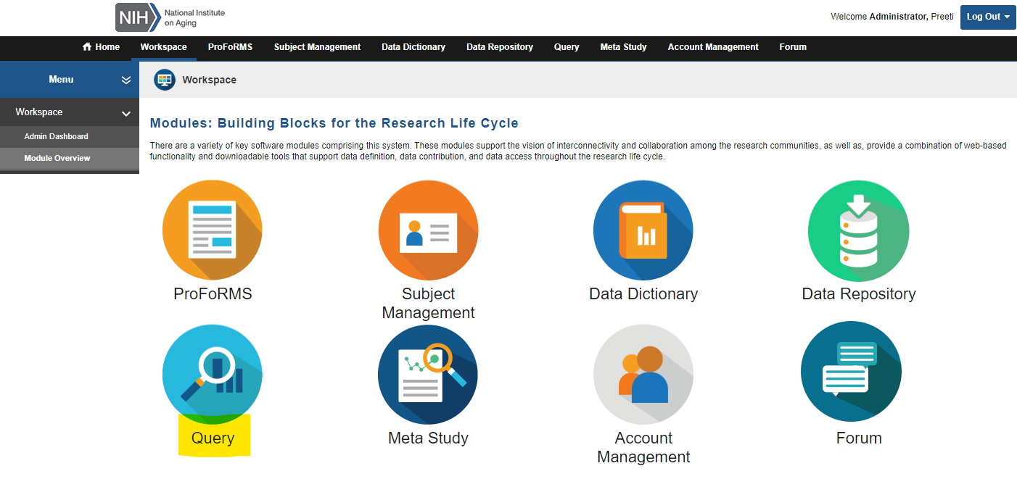
BRICS Modules
Demo on Query Tool module

Slide 11
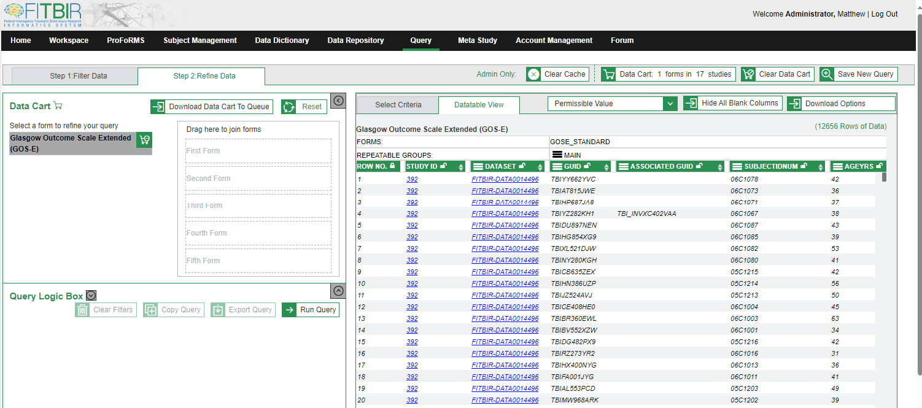
Query Tool
Query across studies, CDEs, and data types
API

Slide 12



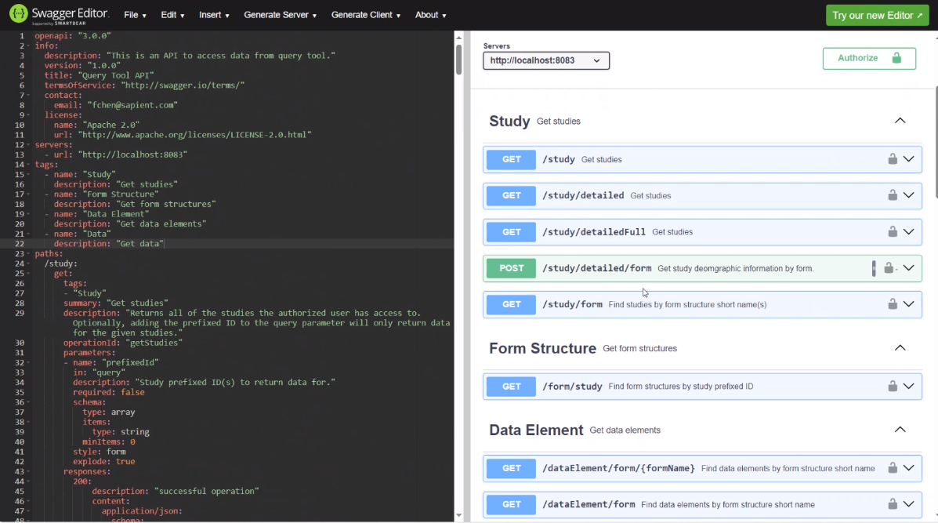
API Query Tool
Programmatic access to the data
Authenticate RAS (11/2023)
Query
Retrieve data
Analysis
FITBIR
Data
Rest
API
PDBP
Data
Researcher
Data Scientist
Jupyter Notebooks
Python, R,
AI/ML libraries
Rest
API
BRICS Informatics
Systems
Notes:
Redesign

Slide 13
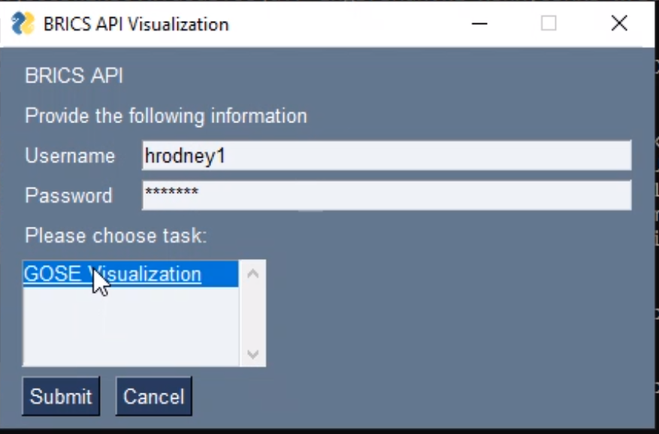
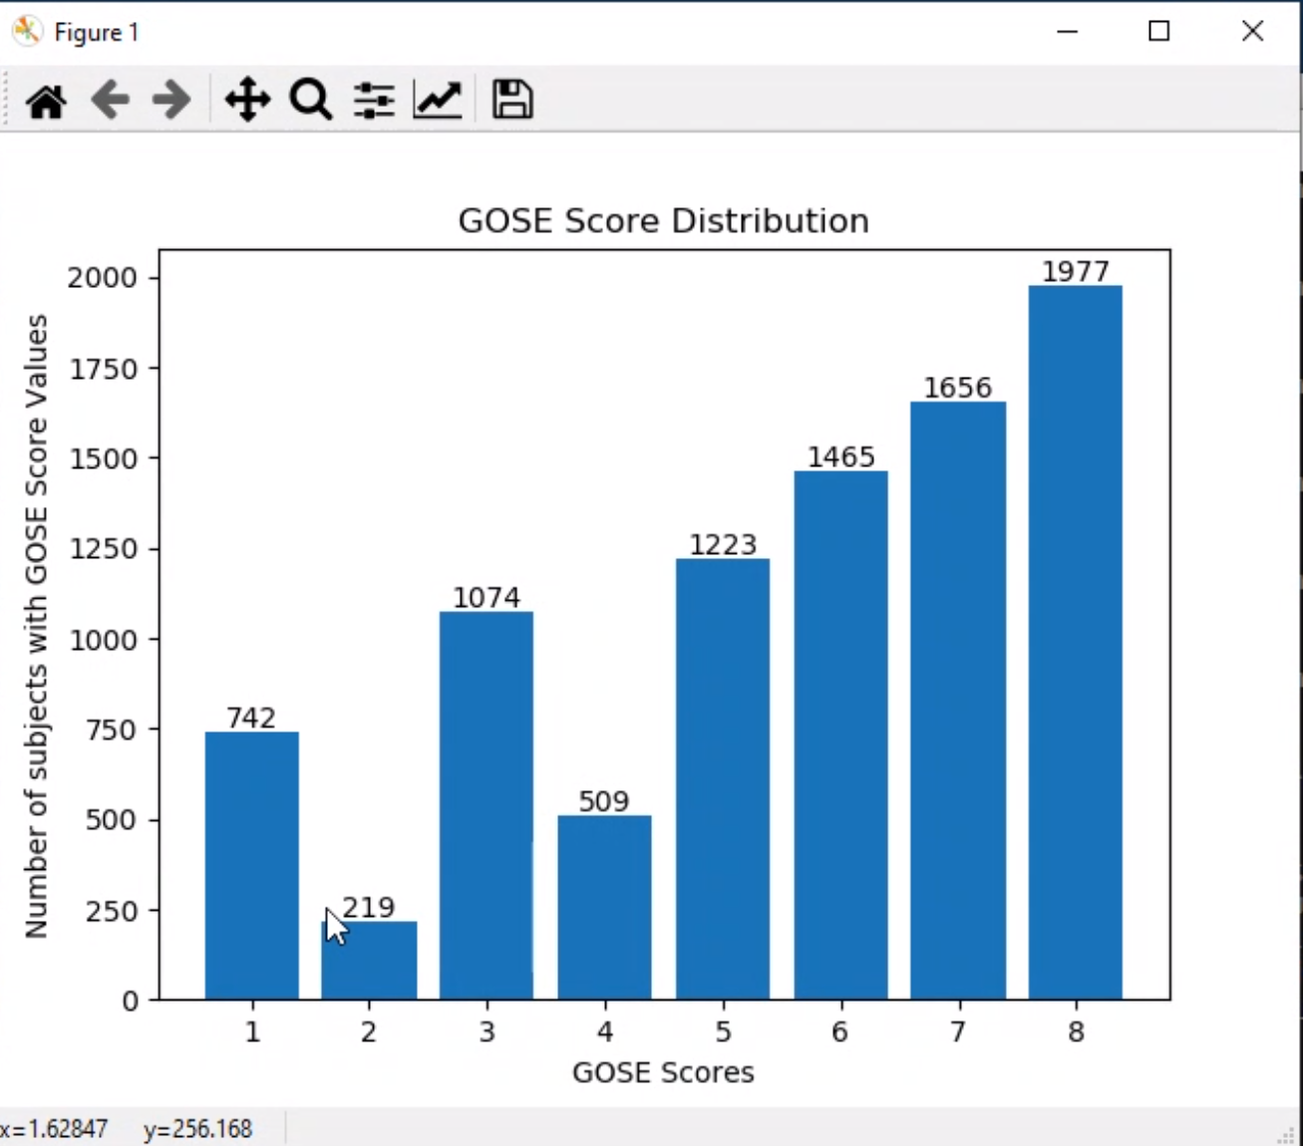
Application GUI – Query/Output
Python Code

Slide 14
Biomedical Research Informatics Computing System (BRICS)
National Institute on Aging (NIA) Pilot Project
Query Tool Use Case
Dr. Saba Al-Sayouri Data Scholar
Notes:
From here – slide 23
Can we unify template?

Slide 15
Studies Overview
BRICS NIA Platform
Study 1: Health & Retirement Study (HRS)
Study 2: Health, Aging, and Body Composition Study (Health ABC)
Study 3: Minority Aging Research Study (MARS)
Study 4: Louisiana Osteoporosis Study (LOS)

Slide 16
BRICS Added Value - Cohort Discovery
Assemble multi-level data collected across lifespan & providing framework for multi-disciplinary work
Expedite epidemiological discovery
Foster communication among investigators leading aging studies
Promote collaborative research projects for topics not easily addressed by single study

Slide 17
Extract Transform Load (ETL) Process Steps
Data access
Define common data elements (CDEs)
Create form structures
Perform data transformation
Data validation & upload

Slide 18
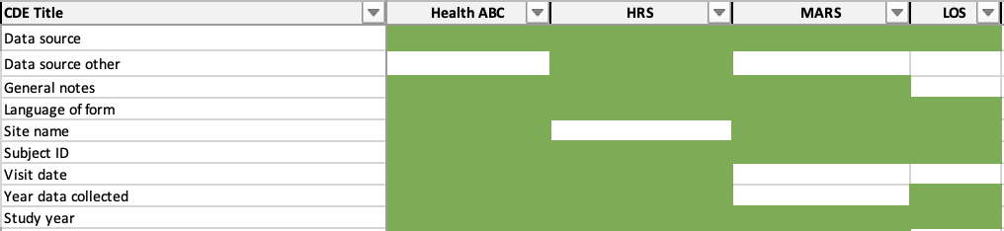
ETL Process Step 1: CDE Definition
Accessed 4 studies data sets
Identified ~120 Common Data Elements (CDEs)
CDE: variable presents in 2+ studies
Iterative process: requires multiple phases of combing through data documentation & dictionaries
Snapshot of Data Inclusion Factsheet

Slide 19
ETL Process Step 2: Creating Form Structures
120 CDEs
NIA Demographics Form
NIA Medical History Form
NIA Vital Signs Form
Daily Living and Physical Ability Form

Slide 20
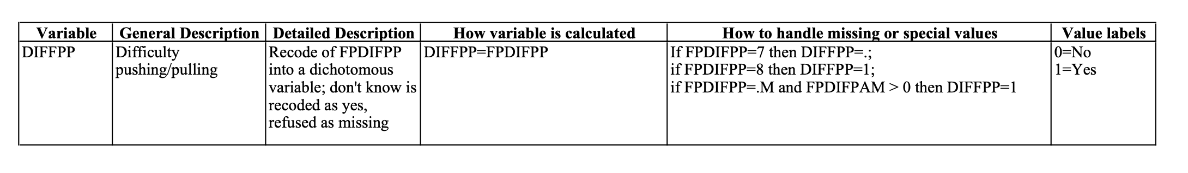
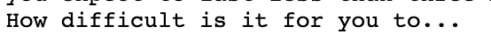
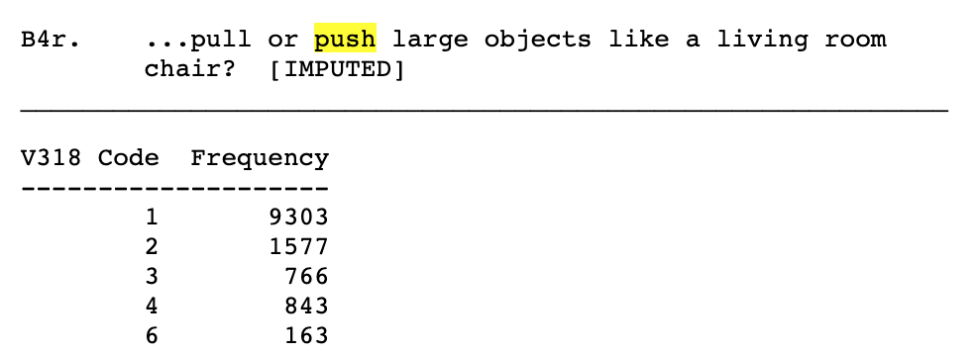
ETL Process Step 3: Data Transformation
Similar CDEs collected differently across studies
Transformed data to fit into BRICS CDE definitions
Health ABC
HRS
Yes
No
✅ Harmonized

Slide 21
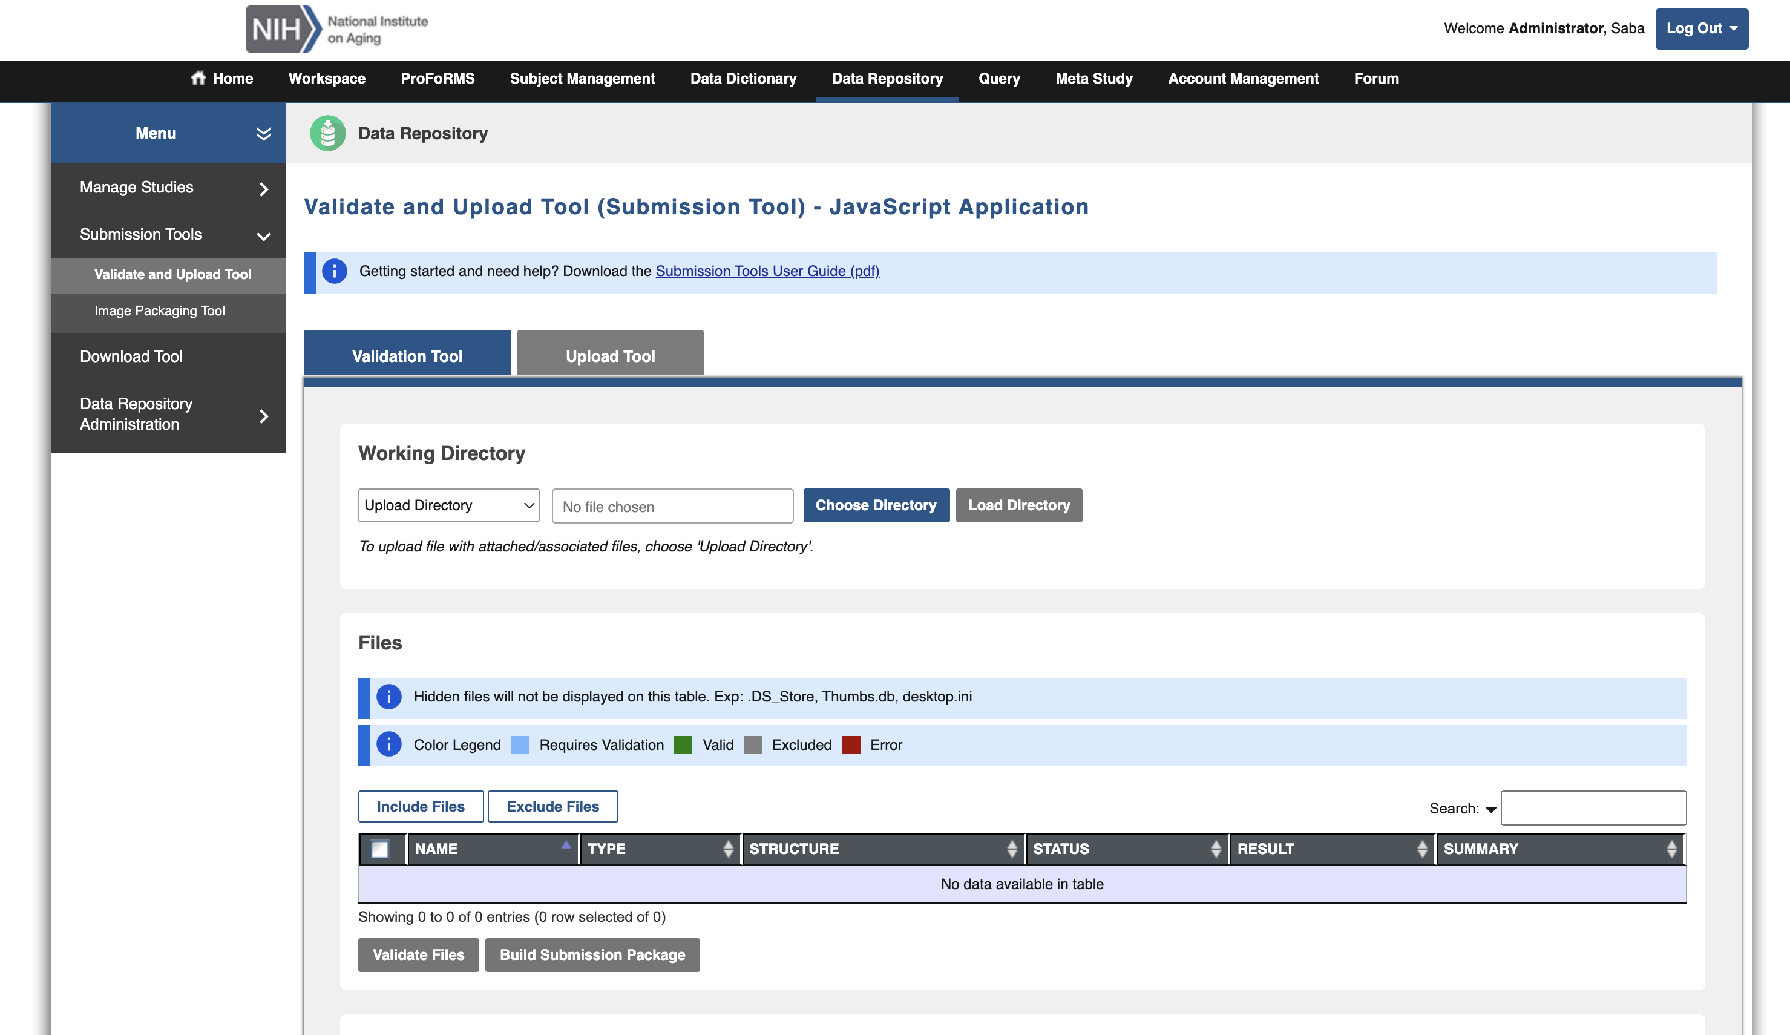
ETL Process Step 4: Data Validation & Upload

Slide 22
Where we Are Now?
~120 harmonized CDEs across 4 NIA studies grouped into 4 form structures reflecting 1 year of study data for 16,613 participants
Uploaded all years available data of MARS study
We’re able to query data across studies, with lots of flexibility in filtering
We’re able to download harmonized data from multiple studies with complete data dictionary

Slide 23
Future Work
Year 1 of HRS full data in process
Still in pilot phase, with all data remaining private
Ability to run analyses, with all data & documentation in clear, accessible, & easy to use format
Working on uploading data for harmonized CDEs for year 2 & across remaining 3 studies (HRS, Health ABC, & LOS)

Slide 24

Demo

Slide 25

Questions?

Slide 26
Biomedical Research Informatics Computing System (BRICS)
Query Tool API & Data Visualization
Dr. Alexandra Bokinsky

Slide 27
API Query Tool
Programmatic access to the data
Authenticate RAS (11/2023)
Query
Retrieve data
Analysis
FITBIR
Data
Rest
API
PDBP
Data
Researcher
Data Scientist
Visualization
Jupyter Notebooks
Python, R,
AI/ML libraries
JavaScript
Rest
API
BRICS Informatics
Systems
Notes:
Redesign

Slide 28
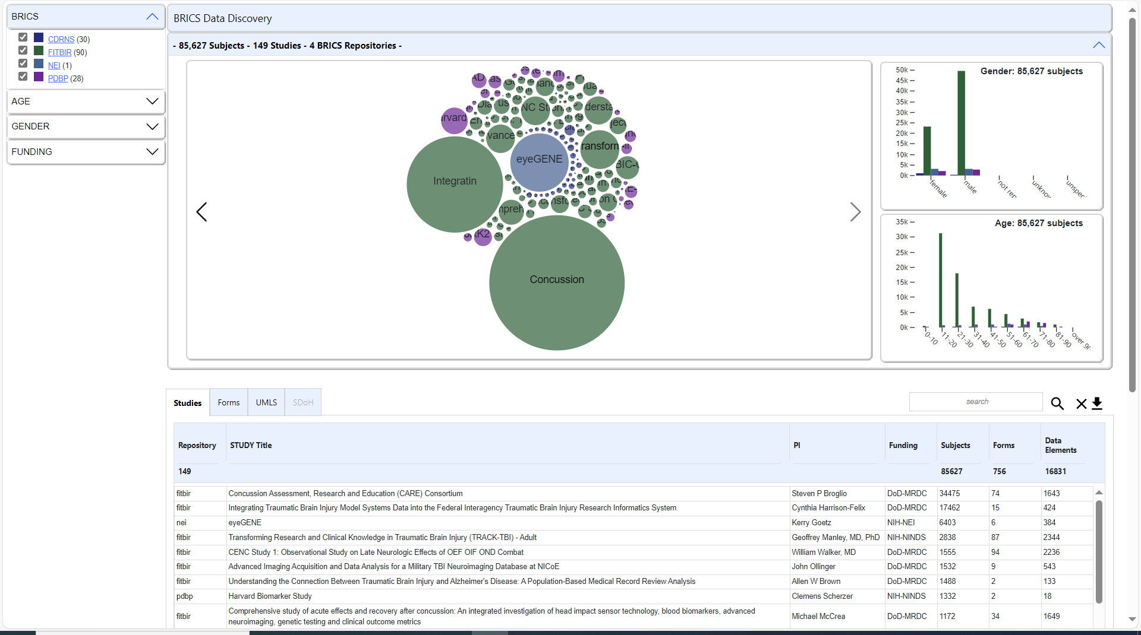
Why would we want to use the API?
Programmable access to the Query Tool includes all QT functionality
Single program runs on any BRICS instance – same code!
Easily build programs to search and integrate data across multiple BRICS instances

Slide 29
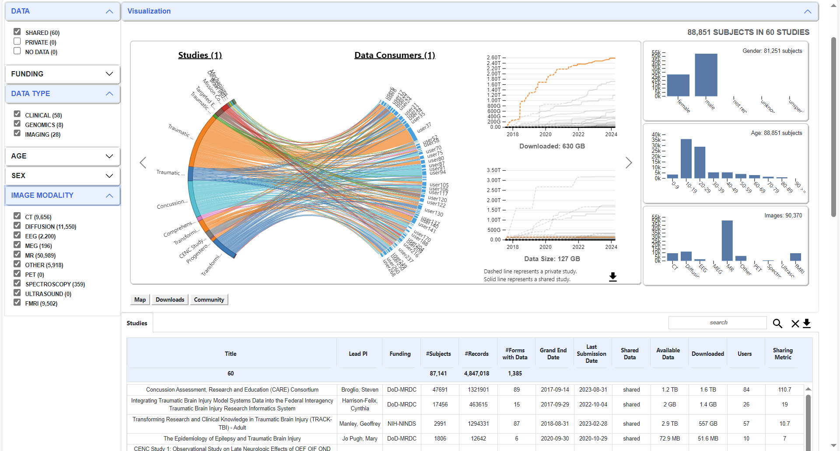
How do we use the API?
Each BRICS instance requires a unique RAS authentication token to access the Query API programmatically.
API calls are identical across instances – only the token and base url change
FITBIR: download activity over time by study, data type, and image modality

Slide 30
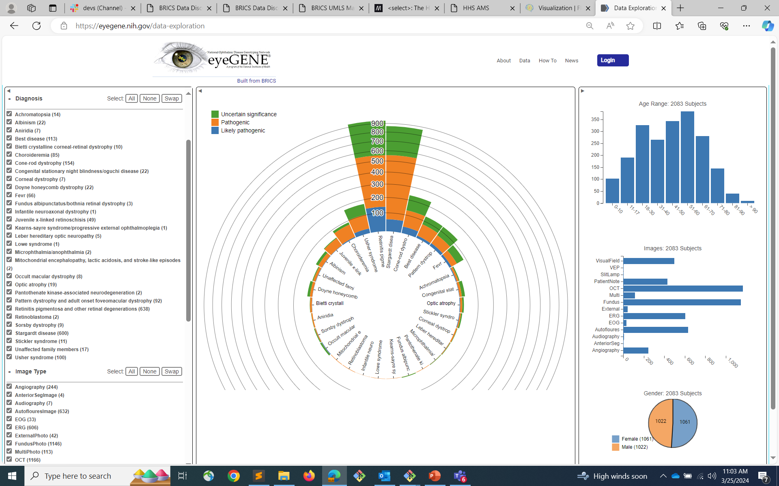
How do we use the API?
Log onto the BRICS workspace and navigate to Account Management
Token expires after 30 minutes
Renew token programmatically from the API:
/rasauth/user/extendApi
Diagnostic information, by age, gender, image type, and gene variant

Slide 31
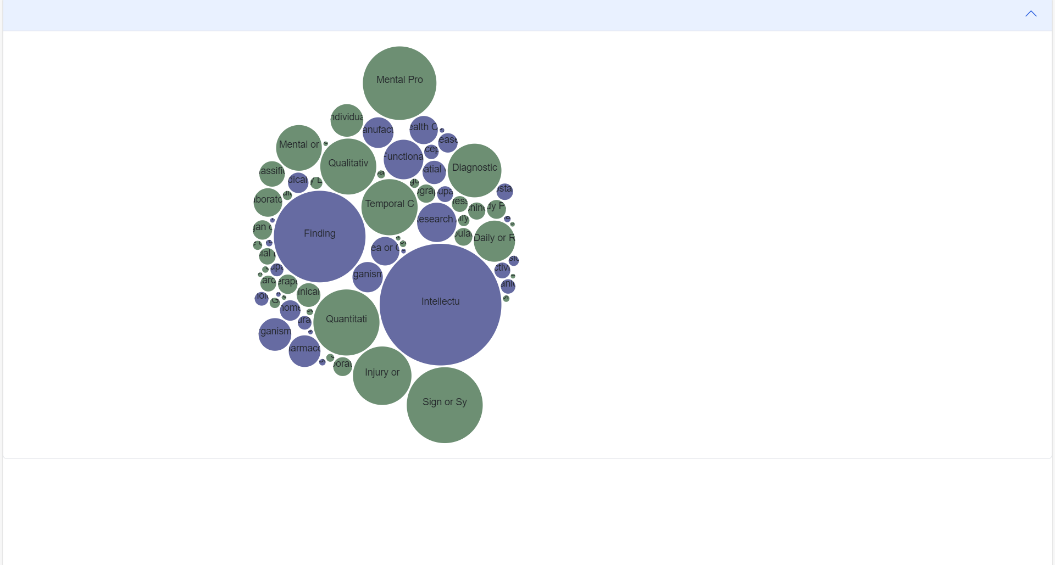
How do we use the API?
/repository-api/study
/query-api/form/study?prefixedId=name
/query-api/dataElement/form?formName=name
/dictionary-api/dataElement/getByNames
Repository-API: List studies available for a given BRICS instance
Query-API: List forms for a given study
Query-API: List data elements for a given form
Dictionary-API: Return dictionary (including UMLS) information for a given CDE

Slide 32
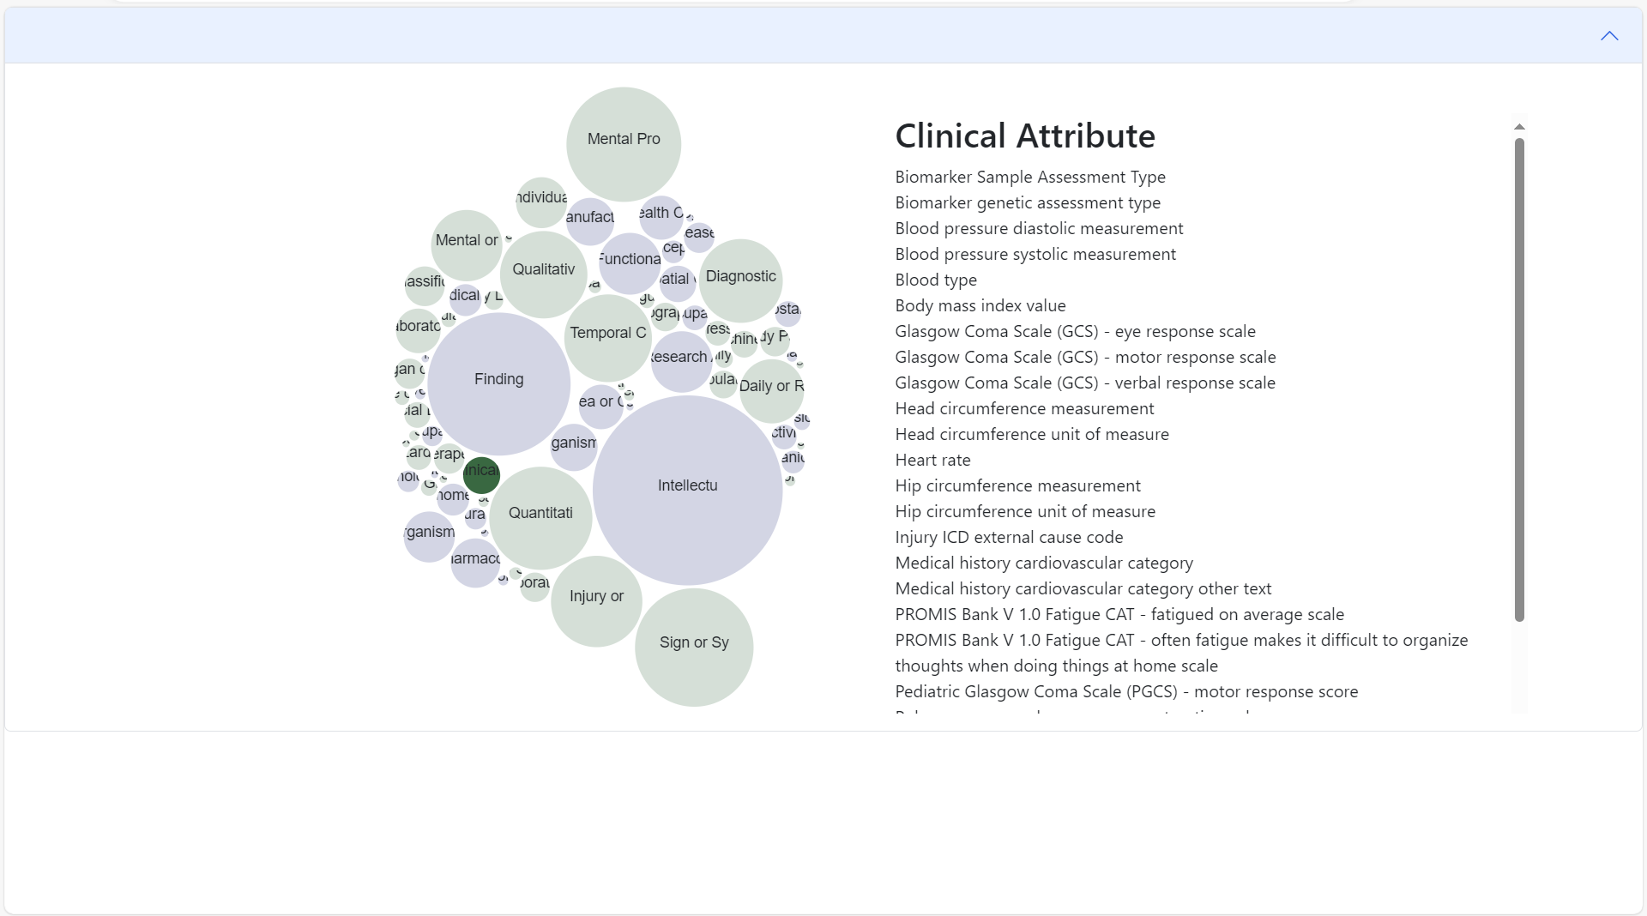
What can we do with the API?
Data elements across BRICS sorted by UMLS Semantic Type
Highlight: Clinical Attribute

Slide 33
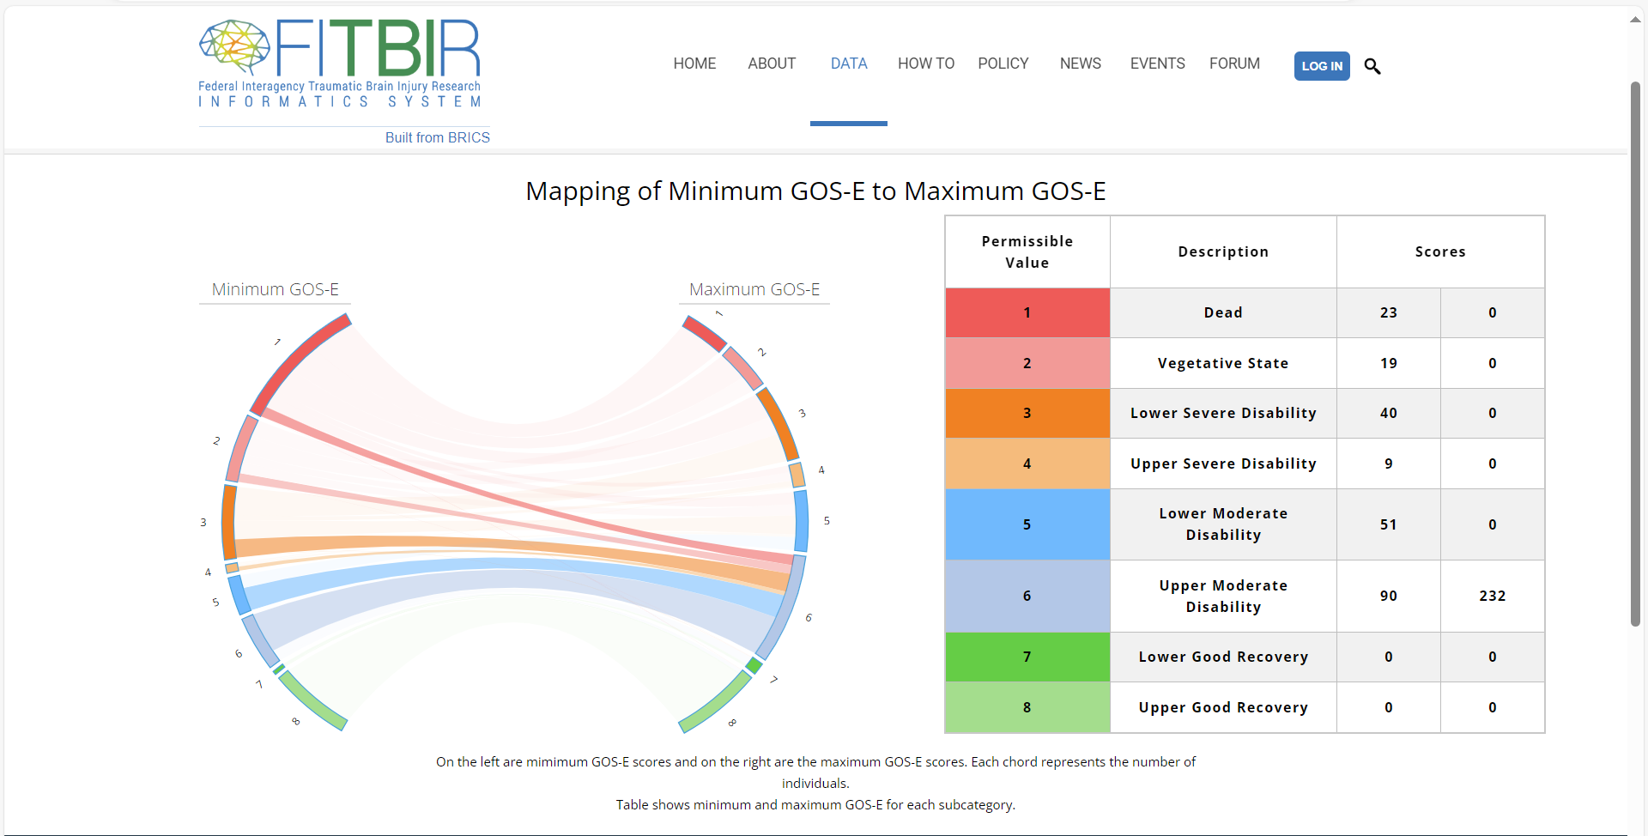
How do we use the API?
Output of API call is in JSON or CSV format:
"studyId": "string",
"forms": [
{
"id": 0,
"shortName": "string",
"title": "string",
"version": "string"
}
]
New ways of looking at and understanding data: GOS-E

Slide 34
Demo

Slide 35
Questions?

Slide 36
Biomedical Research Informatics Computing System (BRICS)
BRICS APIs and Customizing Analysis Pipelines
Dr. Maria Bagonis
Data Scholar

Slide 37
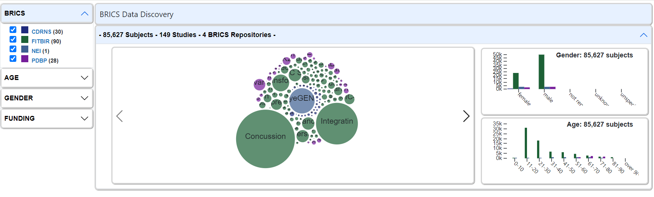
API Query Tool
Programmatic access to the data
For Web Visualization Tools
BRICS Informatics
Systems
Authenticate RAS (11/2023)
Submit Query API Request
Jupyter Notebooks
Python, R,
Java Script
AI/ML libraries
FITBIR
Data
BRICS Web Developer
Or
Researcher
Data Scientist
Rest
API
BRICS DATA
Retrieve Requested Data
Based on Input Parameters
Data Discovery Visualization Tools
https://brics.cit.nih.gov/visualization
Notes:
Redesign

Slide 38
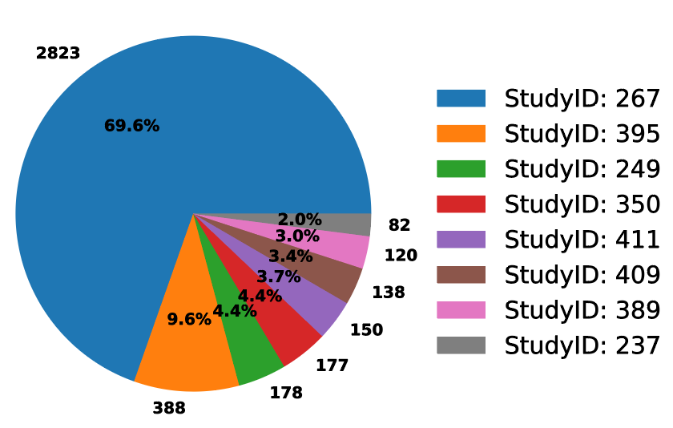
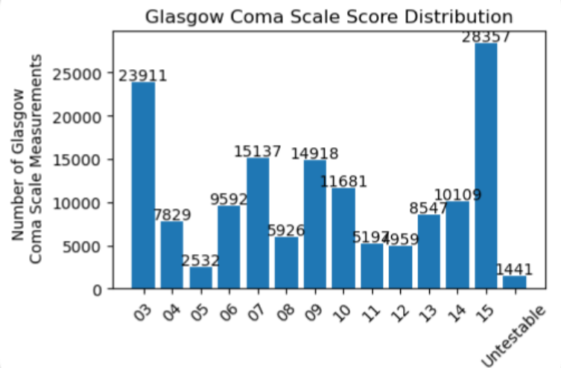
API Query Tool
Programmatic access to the data
For Customized Local Analyses
BRICS Informatics
Systems
Authenticate RAS (11/2023)
Submit Query API Request
Jupyter Notebooks
Python, R,
Java Script
AI/ML libraries
FITBIR
Data
Researcher
Data Scientist
YOU!
Rest
API
Locally Design Customized
Visualizations, Analyses, and
Cohort Generation Tools
BRICS DATA
Retrieve Requested Data
Based on Input Parameters
# of Subjects Per Study Using the GCS Form
Notes:
Redesign

Slide 39
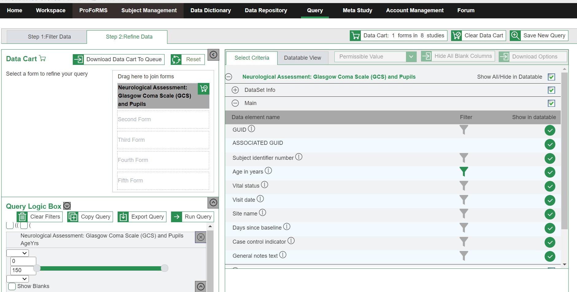
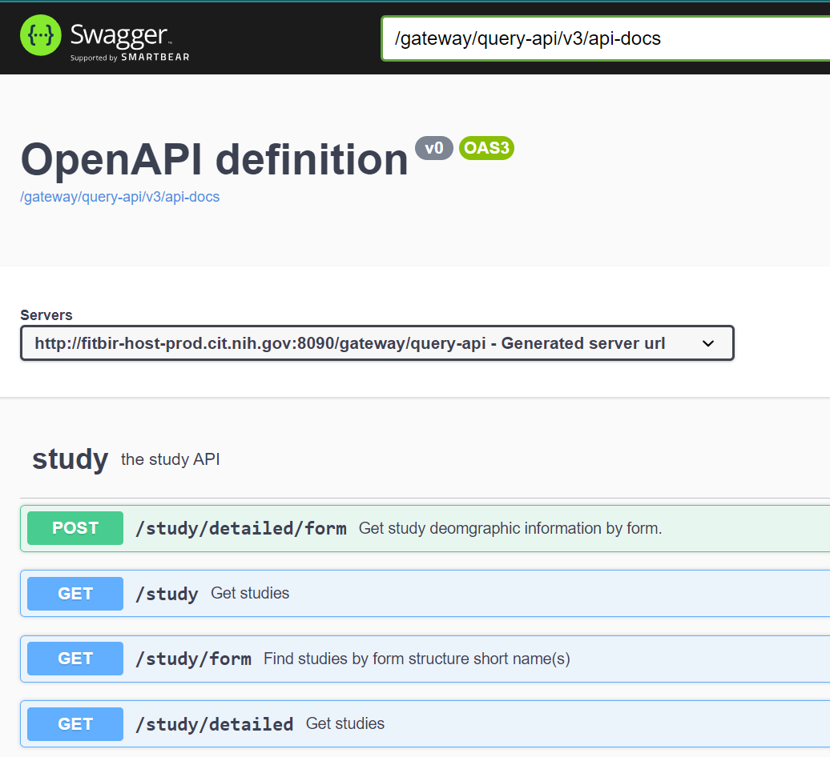
BRICS Query Tools
Browser-Based Query Tool
API Endpoints
User Guide: https://brics.cit.nih.gov/sites/brics/files/2024-02/query-and-api-to-data-query-user-guide.pdf
Tutorial Videos:
BRICS Query Tool Introduction: https://www.youtube.com/watch?v=pDukXHWfIBw
BRICS Query Tool Step1: Filter Data:
https://www.youtube.com/watch?v=uJ0HeLEGVQA
BRICS Query Tool Step2: Refine Data:
https://www.youtube.com/watch?v=8sL45VF7bx0
Github Page With User Guide and Example Code: https://github.com/brics-dev/data-discovery-api
API Swagger Definitions: (ie where to find API endpoints)
FITBIR: https://fitbir.nih.gov/gateway/query-api/swagger-ui/index.html
PDBP: https://pdbp.ninds.nih.gov/gateway/query-api/swagger-ui/index.html
NEI: https://brics.nei.nih.gov/gateway/query-api/swagger-ui/index.html
CdRns: https://cdrns.nih.gov/gateway/query-api/swagger-ui/index.html

Slide 40
BRICS Query Tools
Browser-Based Query Tool
API Endpoints
Things you can do:
Find all form structures submitted for a study
Find all studies using a specific form structure (ex. Glasgow Coma Scale (GCS) form in FITBIR)
Query data across multiple studies and form structures
Filter results based on data element values (ex. Age, Days Since Baseline, GCSTotal Score)
Perform joins across form structures (ex. GCS and Diffusion Imaging in FITBIR)
Download files associated with query results *Note: We are actively working on workflows for numerous large files (ie, imaging, etc)
Designed with similar functionality

Slide 41
Difference between Browser and API Query Tool
Browser-Based Query Tool
API Endpoints
*Allows Movement toward
Automated Workflows/Pipelines
Graphical Interface Query
Command Line Query from analysis
software (Jupyter Notebook etc)
Check out BRICs Data to Cart
Load BRICS data directly into analysis
software (Jupyter Notebook etc)
Download BRICs Data via Browser
Upload BRICs data into
analysis software (Jupyter Notebook etc)

Slide 42
Why would we want to use the API?
The API provides programmatic access to the Query Tool
Data accessors can use the Query Tool services in their own programs & notebooks
Using the API extends the power of the Query Tool
Directly download query results to any analysis software that supports REST APIs (Jupyter Notebook/python, R, java-script, etc)
Instantly create plots of BRICs data returned
Customize data analysis/transformation pipelines and easily apply them to multiple queries
Share archived queries and analyses with others.

Slide 43
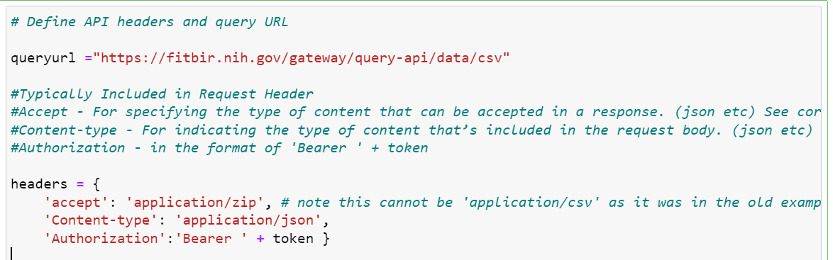
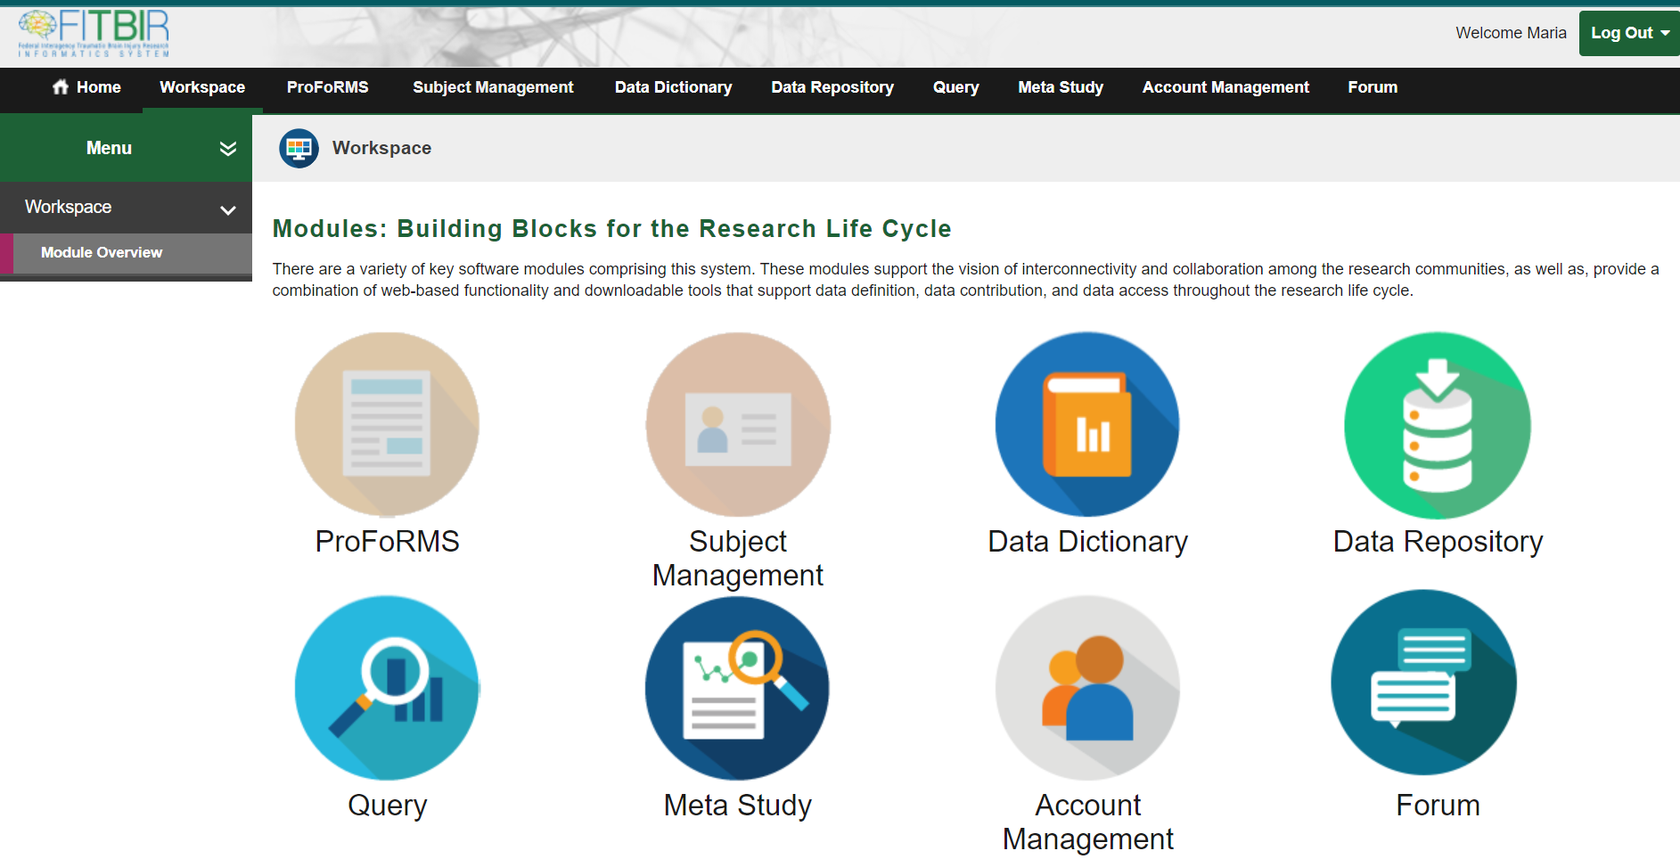
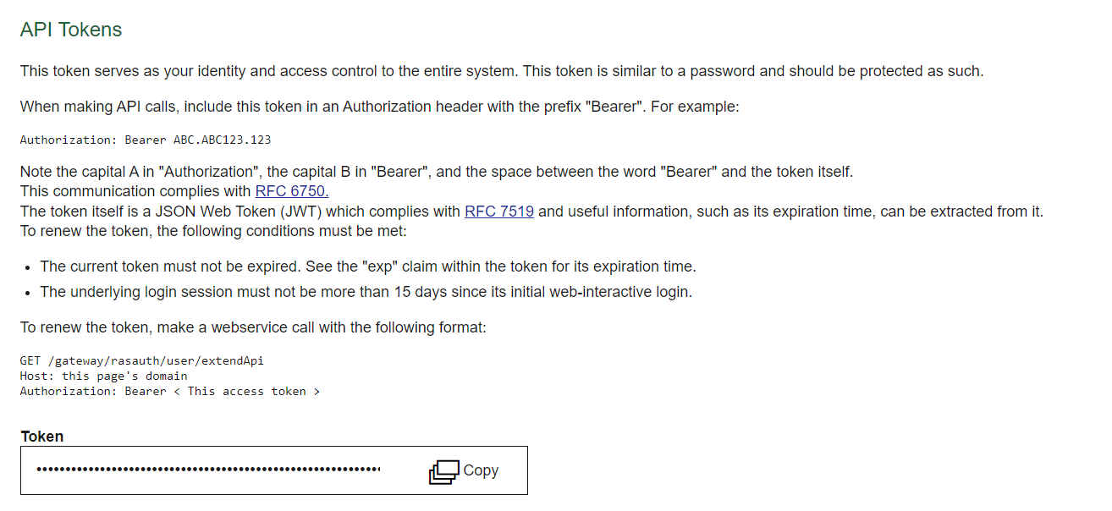
Steps to Using the
API: Step I
Step I: Define Query URL (ie ‘API endpoint’), Header, and Authorization Token
https://fitbir.nih.gov/gateway/query-api/swagger-ui/index.html#/data/getInstancedDataCsv

Slide 44
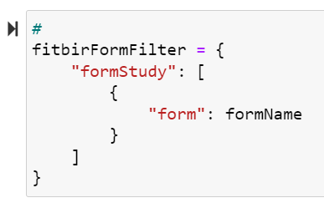
Steps to Using the
API: Step II and III
Step II: Define the Request Body (i.e. the Query Filter Information)
Defined on Swagger Website:
Ex. See Here https://fitbir.nih.gov/gateway/query-api/swagger-ui/index.html#/data/getInstancedDataCsv for more information regarding acceptable request body formats
Step III: Run the Query
Develop Local Custom Visualization, Analyses, Cohort Generation Pipelines!
BRICS Data

Slide 45
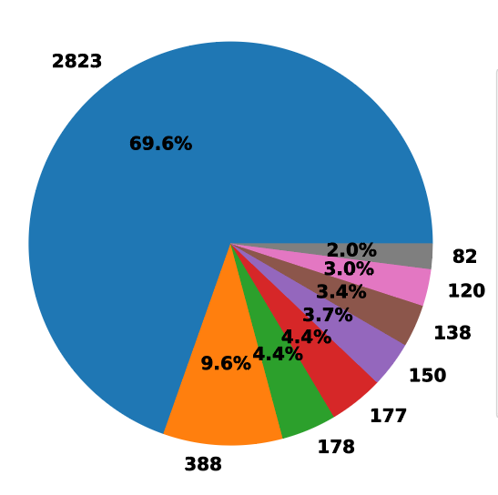
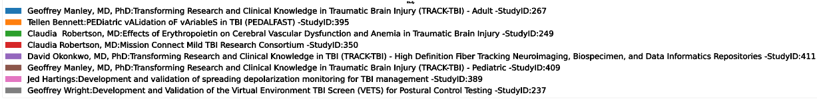
API Query Tool
Examples of Customized Visualization
Find all studies in an instance of BRICs (ex. FITBIR) using a specific form (ex. Glasgow Coma Scale) View the Distribution of Data Element Values (ex.GCS Total Score) among those studies
# Subjects Per Study Using GCS Form
Total N = 4056
FITBIR Studies
See Python Notebook:
BRICSAPIDemo_CollectDataByForm.ipynb
Notes:
Redesign

Slide 46
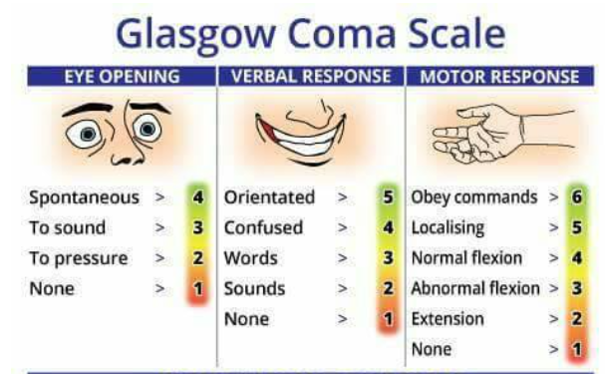
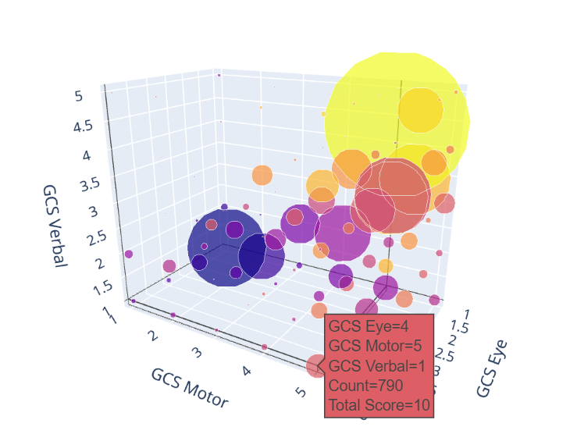
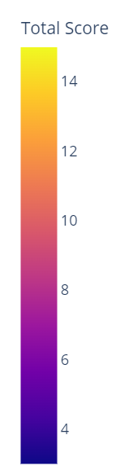
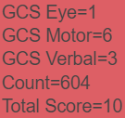



API Query Tool
Examples of Customized Visualization
Large Sample Sizes Afforded by Combining Data Among Multiple Studies Can Reveal Important Heterogeneity in the Patient Population and Ensure Sampling of Less Common Sub-populations
Count
28000
8000
800
See Python Notebook: BRICSAPIDemo_CollectDataByForm.ipynb
Notes:
Redesign

Slide 47
API Demo

Slide 48
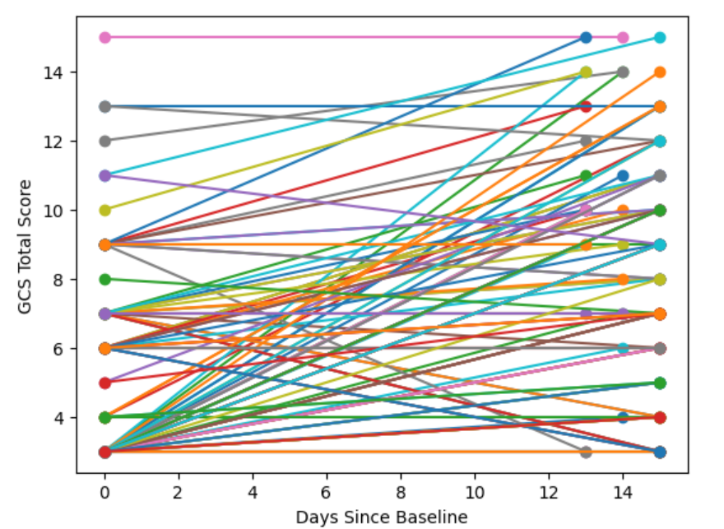
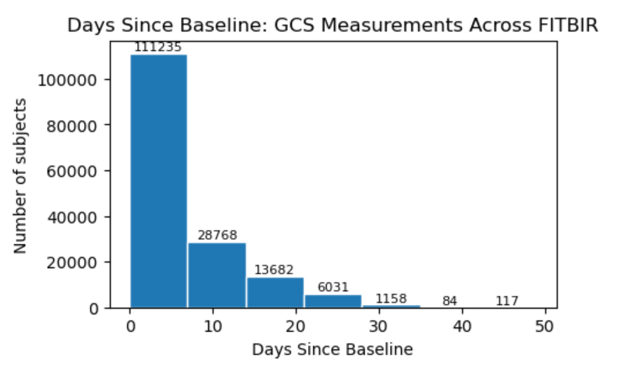
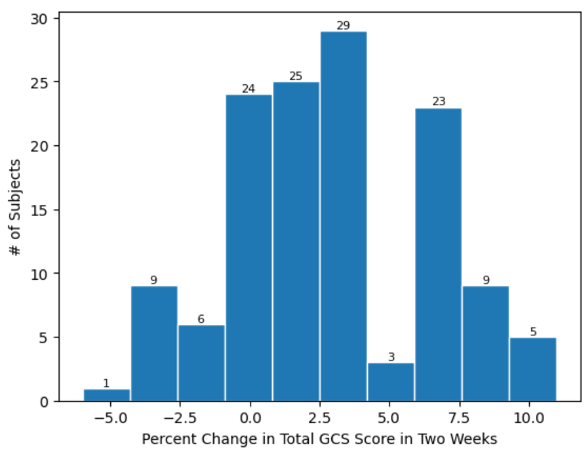
API Query Tool
Examples of Customized Visualization (Extra)
Extracting Temporal Measurements:
Glasgow Coma Scale (GCS) Measurements Taken at Different Times Since Injury
At Time
of Injury
Two Weeks
Post Injury
134 Subjects with GCS Measured BOTH at 0 and ~14 days after injury
Worsened
Improved
Time of Injury
See Python Notebook: BRICSAPIDemo_CollectDataByForm.ipynb
Notes:
Redesign

Slide 49
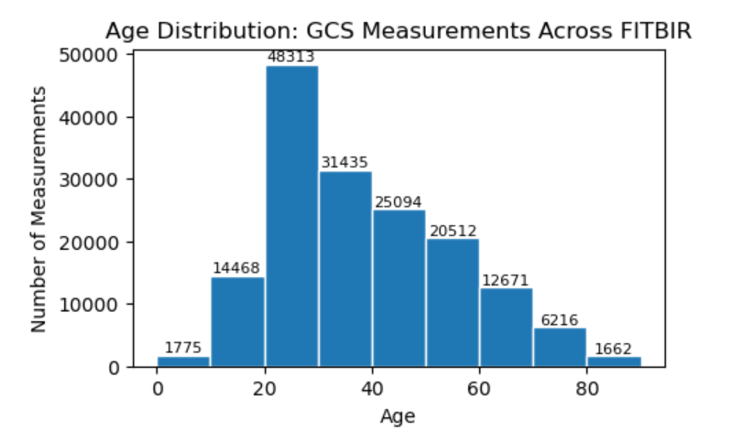
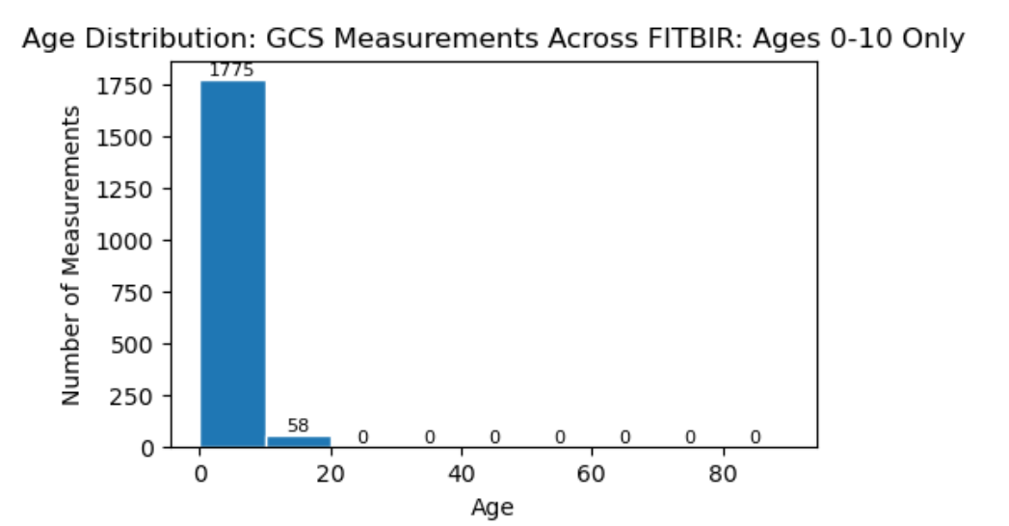
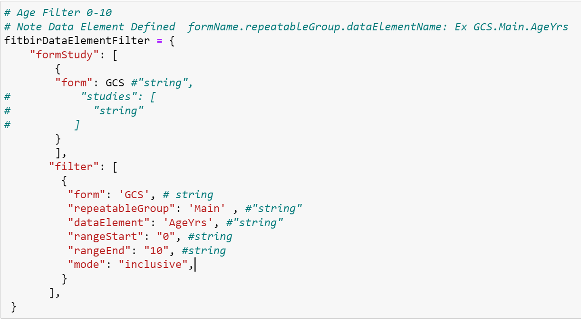
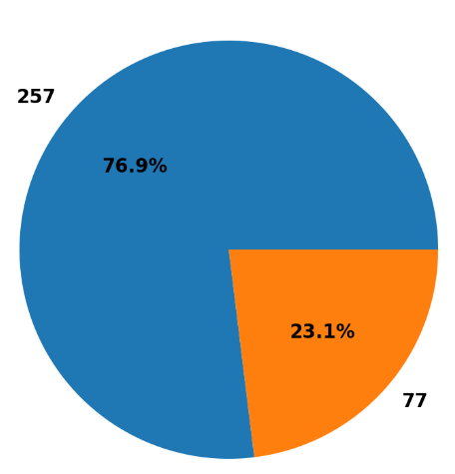
API Query Tool
Examples of Customized Visualization (Extra)
Find all studies using a specific form structure and filter by Data Element Value as defined by form.repeatableGroup.dataElement (i.e GCS.Main.AgeYrs)
Create Pediatric Filter
Only Download Data: Ages 0-10
# Subjects Per Study Using GCS Form
See Python Notebook: BRICSAPIDemo_CollectDataByForm_WithDataElementValueFilter.ipynb
Notes:
Redesign

Slide 50
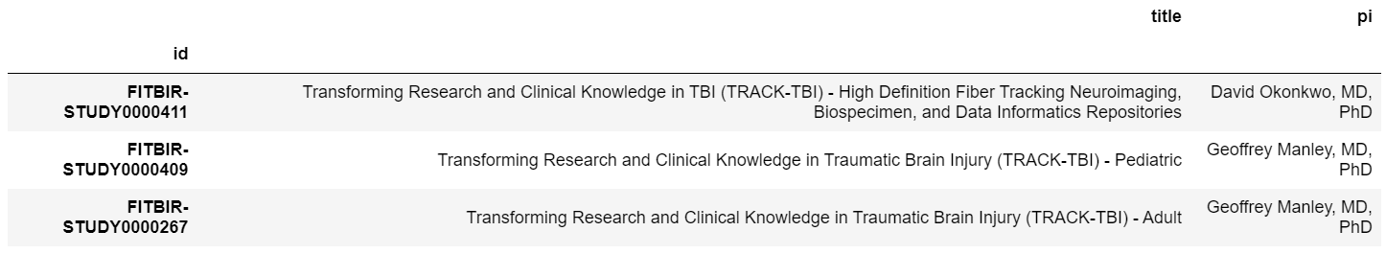
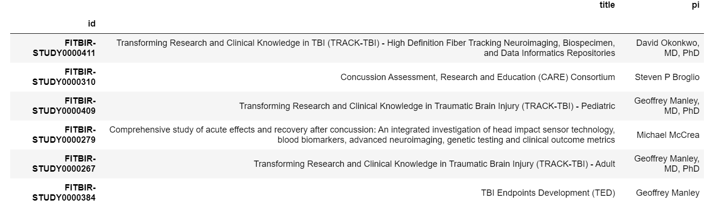
API Query Tool
Examples of Customized Visualization (Extra)
Find all studies using BOTH ImagingDiffusion and GCS forms:
Find all studies using BOTH Biomarker and ImagingFunctionalMR forms:
See Python Notebook: BRICSAPIDemo_FindStudiesUsingTwoOrMoreCommonForms.ipynb
Not the form you are looking for?: Interactively Search All FITBIR Forms via the web interface here:
https://fitbir.nih.gov/content/data-dictionary#form-structures
Notes:
Redesign

Slide 51
API Query Tool
Examples of Customized Visualization
Insert Your Visualization Here!
Visit:
https://github.com/brics-dev/data-discovery-api
To find a Github Page Including a Query-API User Guide (PDF/Jupyter Notebook) and all of the Example Notebooks From Today’s Webinar
Questions/Comments?
Additional Questions/Comments/Suggestions
Contact: maria.bagonis@nih.gov
Share your voice and be part of the community!
Notes:
Redesign

Slide 52

Closing Remarks

